Slide 1

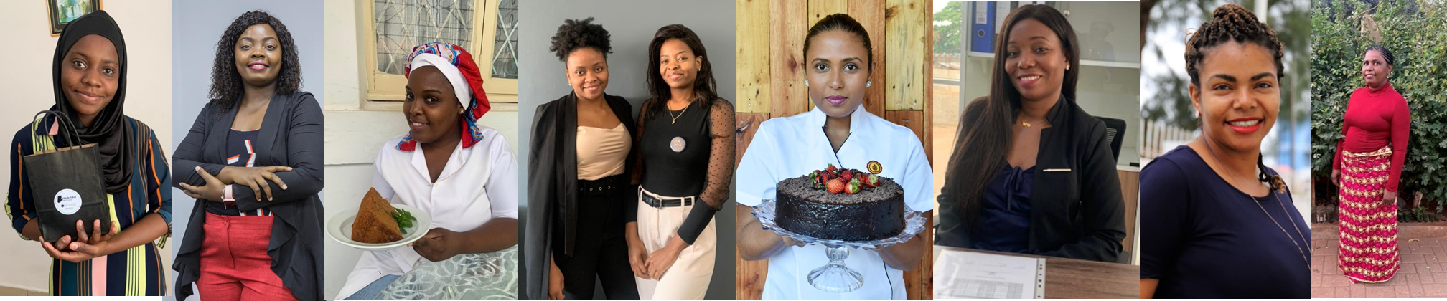
Report
Profile of REALIZA Entrepreneurs
From Mobilization

Slide 2


Report objective
Report main objectives:
Describing the profiles of female entrepreneurs mobilized for the REALIZA Program in order to understand which profiles expressed interest in enrolling in the program during the mobilization period;
Identify whether there are new strategies that can be used to mobilize the profile idealized for the REALIZA Program based on the data available.

Slide 3
Report Outline
Mobilization Processo for the REALIZA Program:
1.1 What was done in the mobilization process for the REALIZA Program?
1.2 Main challenges and main learnings from the mobilization process
2. Profile description of the six thousand female entrepreneurs mobilized
2.1 Geography, formalization and profit (areas for next mobilization with the profile needed)
2.2 Type of business and formalization (identify if we should focus on specific types of business)
2.3 Type of business, profit and number of workers (identify if there is any relation about those variants)
2.4 Age and formalization (identify if there is a trend about age of entrepreneurs and formalization)
2.5 Social media and profit (identify if social media management can be related to better profit)
2.6 Years of the business and profit (identify if there is a relation between old and new businesses about profit)
3. Profile description of the two thousand eligible entrepreneurs
2.1 Geography, formalization and profit
2.2 Type of business and formalization
2.3 Type of business, profit and number of workers
2.4 Age and formalization
2.5 Social media and profit
2.6 Years of the business and profit
4. Key strategic considerations for future mobilization

Slide 4
Mobilizadas

Slide 5
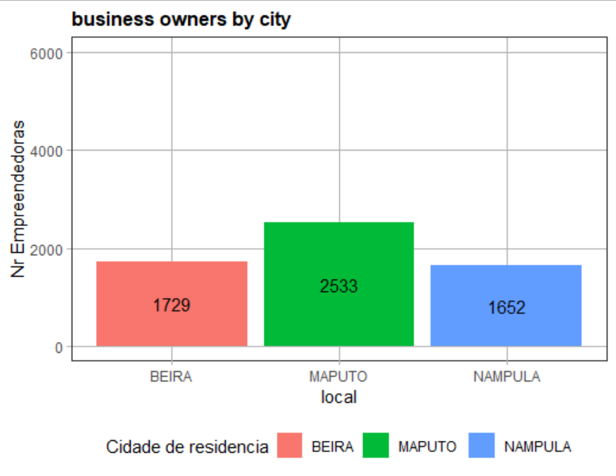
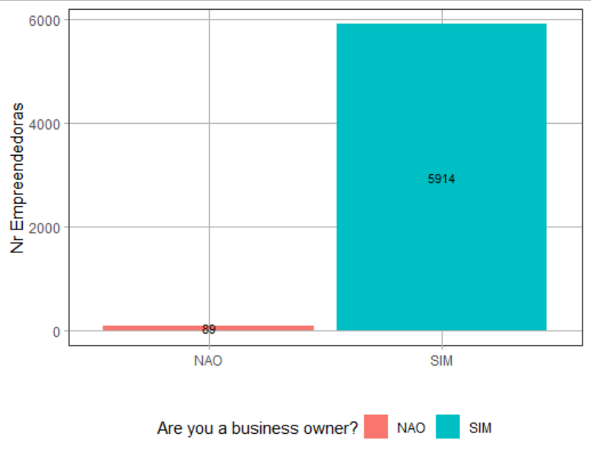
Mobilizadas
There were 6003 entrepreneurs mobilized of which 89 were not business owners. We note that these business owners registered online.
N=6003
N=5914

Slide 6
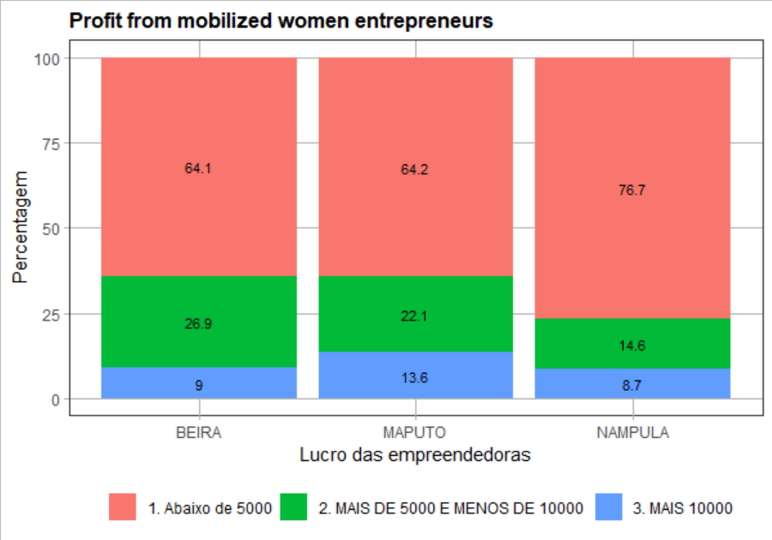
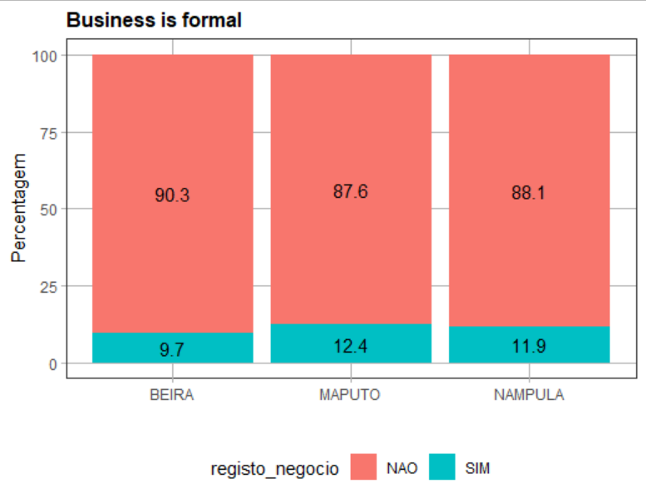
In all cities, women entrepreneurs earning more than 10,000 meticais do not reach 15%. Beira has the lowest percentage (9%) of female entrepreneurs earning at least 10,000 meticais.
More than 80 percent of women, their businesses are not formalized.
N=5914
N=5914
(N=1729)
(N=2533)
(N=1652)
(N=1729)
(N=2533)
(N=1652)

Slide 7
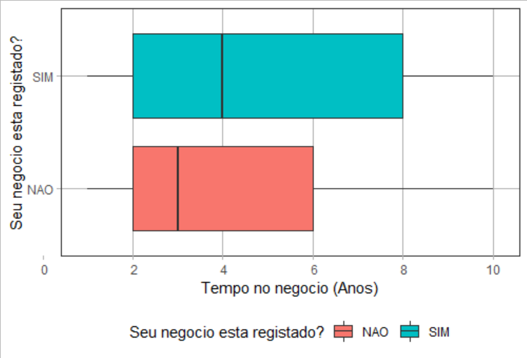
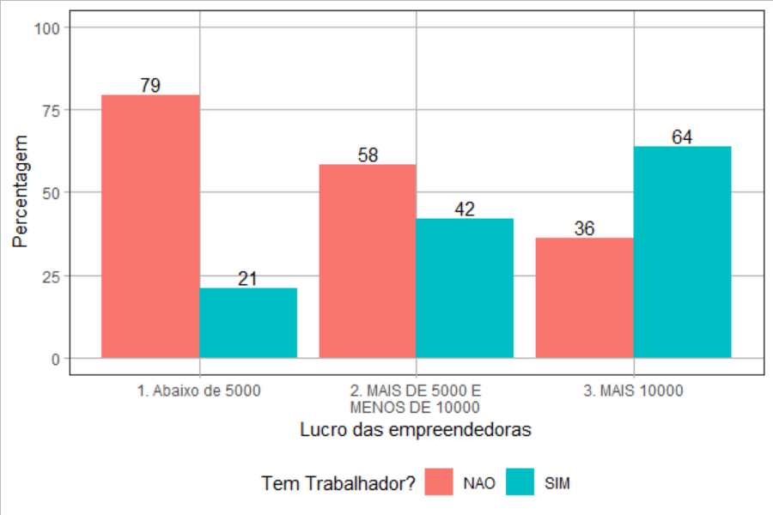
The businesses of registered female entrepreneurs are on average 4 years old, while unregistered businesses are on average 3 years old.
Podemos notar que temos mais empreendedoras com negocio registado com mais tempo no mercado comparativamente as empreendedoras sem registo onde a maioria delas não tem mais de 6 anos no mercado.
The higher the profit of female entrepreneurs, the greater the chance of the business being registered.
N=5914
N=5914
N=5236
N=678
N=4002
N=1267
N=45

Slide 8
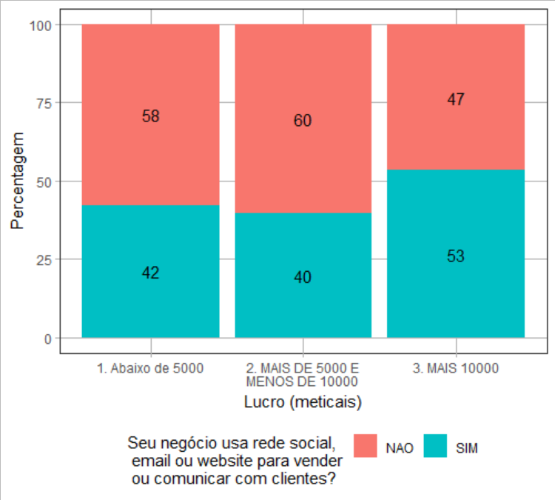
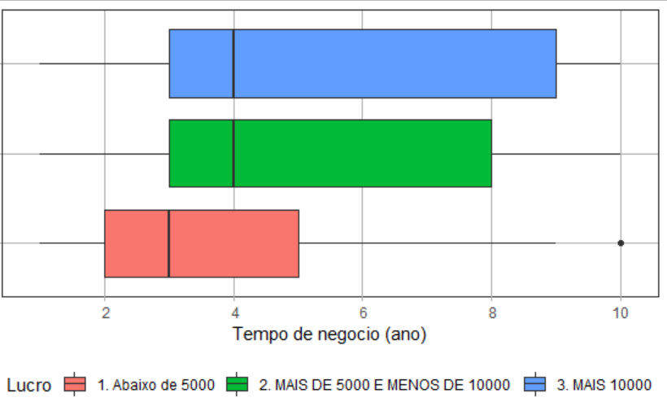

Slide 9


Seleccionadas

Slide 10
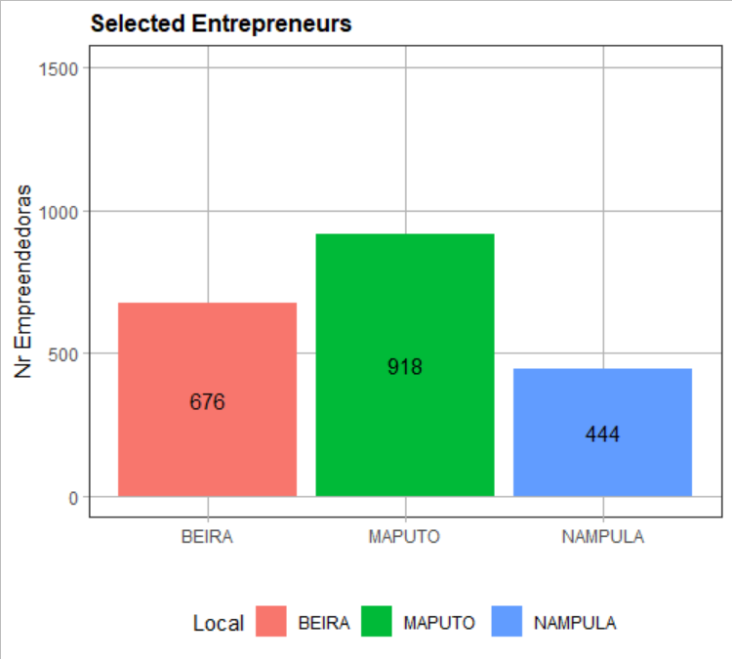
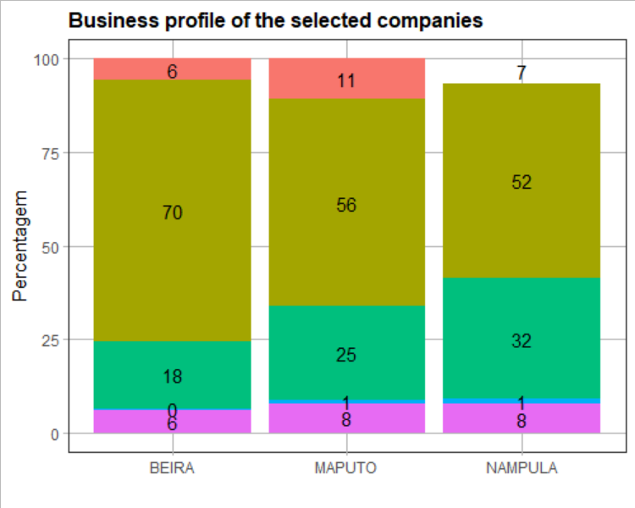
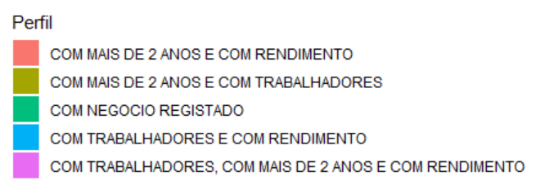

Slide 11
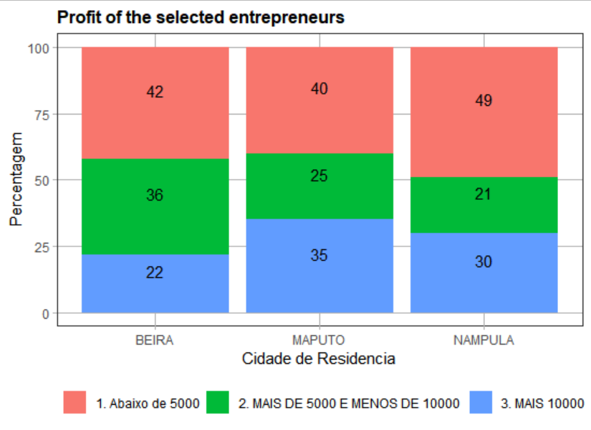
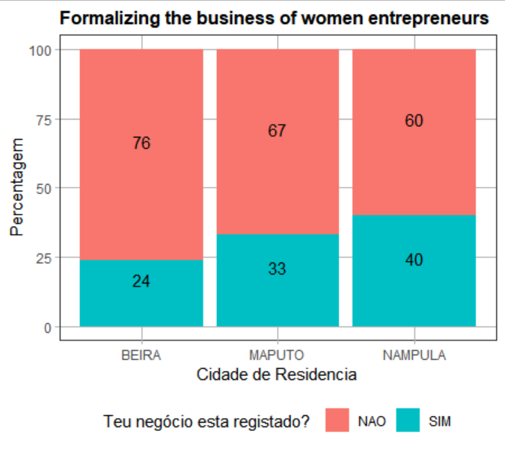

Slide 12
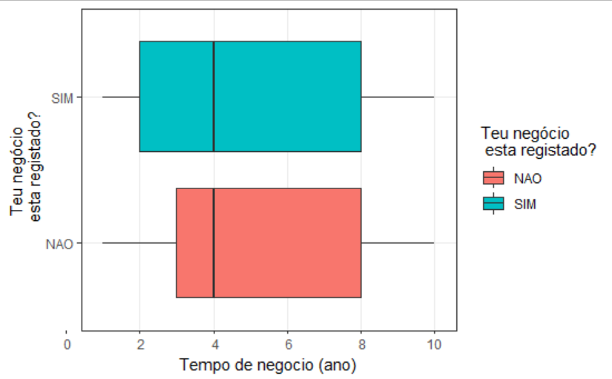
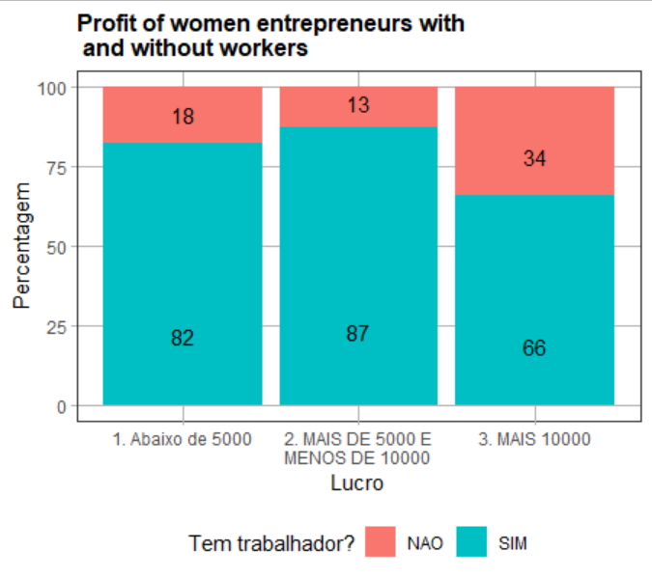

Slide 13
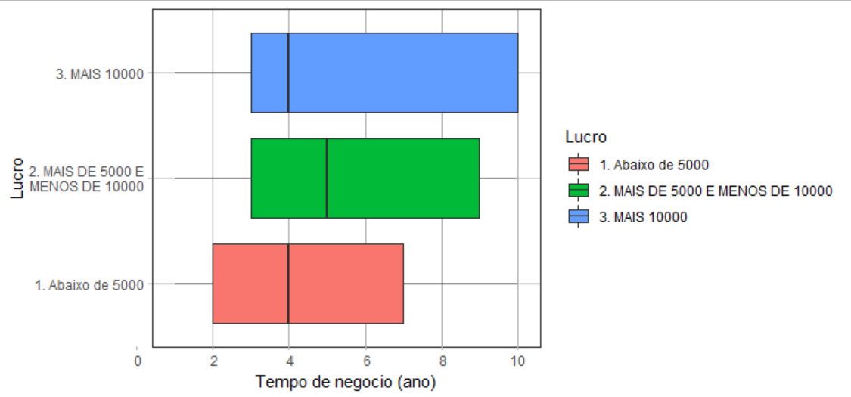
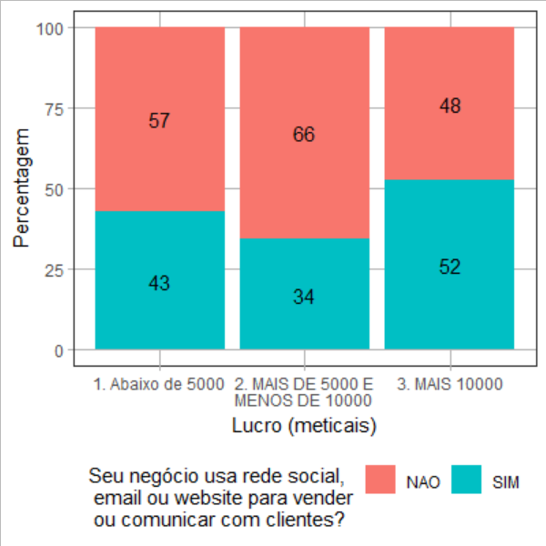

Slide 14
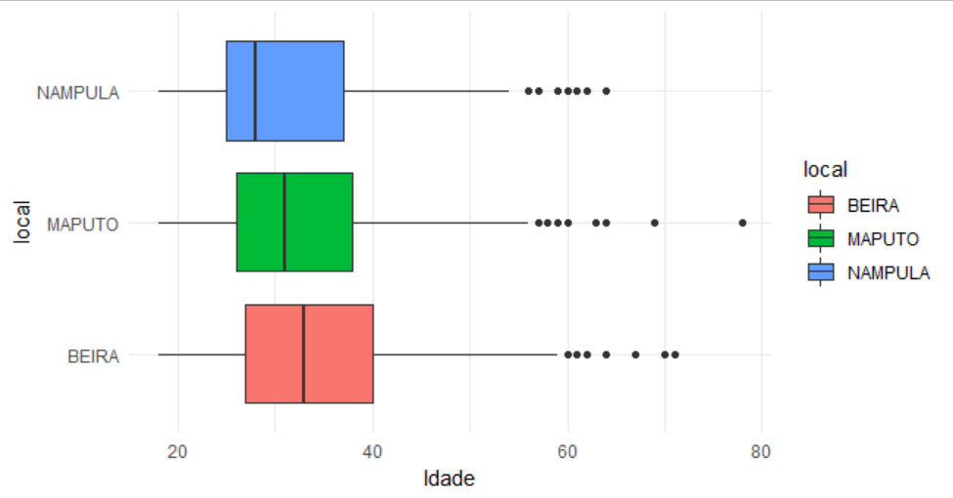
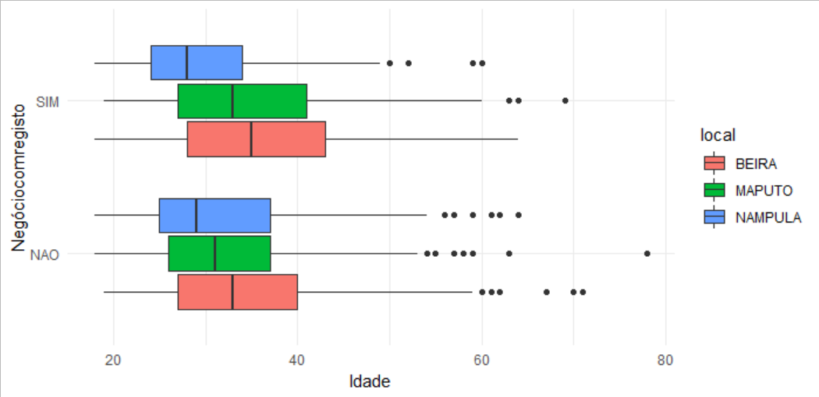
Mais de 63% das seleccionadas tem idade compreendida entre 25 a 45 anos. A Idade não é um factor que influencia a formalização das empreendedoras.

Slide 15
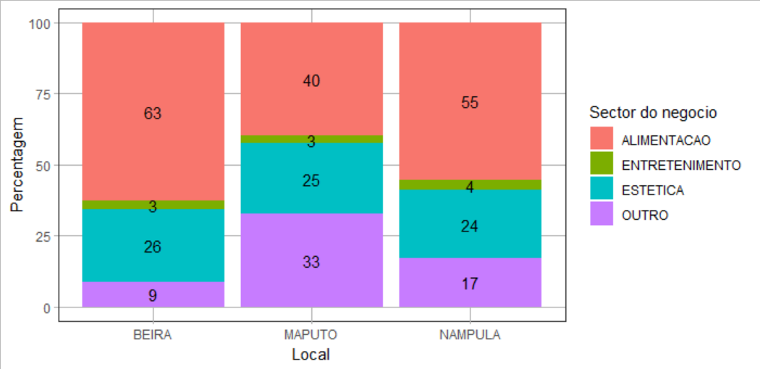
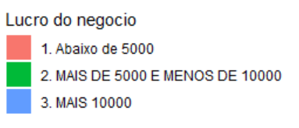
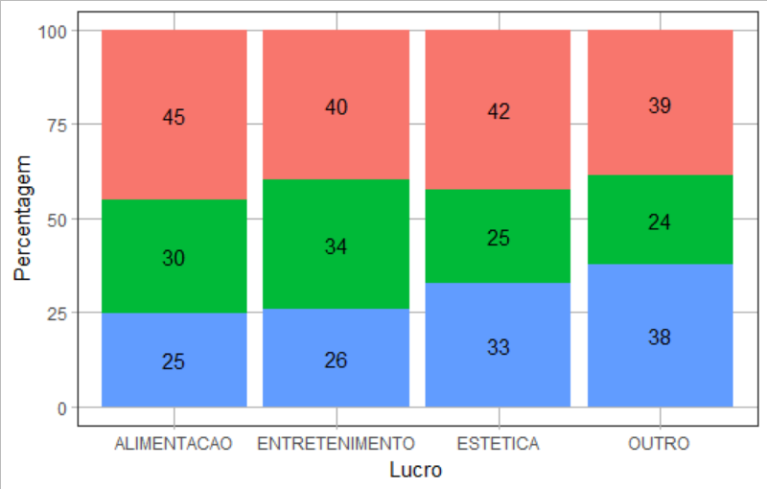
O Sector Alimentício é mais predominante nas empreendedoras seleccionadas, porém o sector de negócio não influencia no rendimento das empreendedoras.

Slide 16
Report Production Plan
26TH October
MUVA Team and the WB agree the chosen data.
4th November
Graphs produced with the data selected
18th November
Graphs analyzed and first draft of the report shared with the MUVA team for review
25th November
Document reviewed by MUVA team
30th November
First version of the report delivered to the WB team

Slide 17
Apenas Alim
Apenas estet
Alim e este
Alim e out
Est e out
outros

